Slide 1

Current ship mark printed to A4 paper

Slide 2
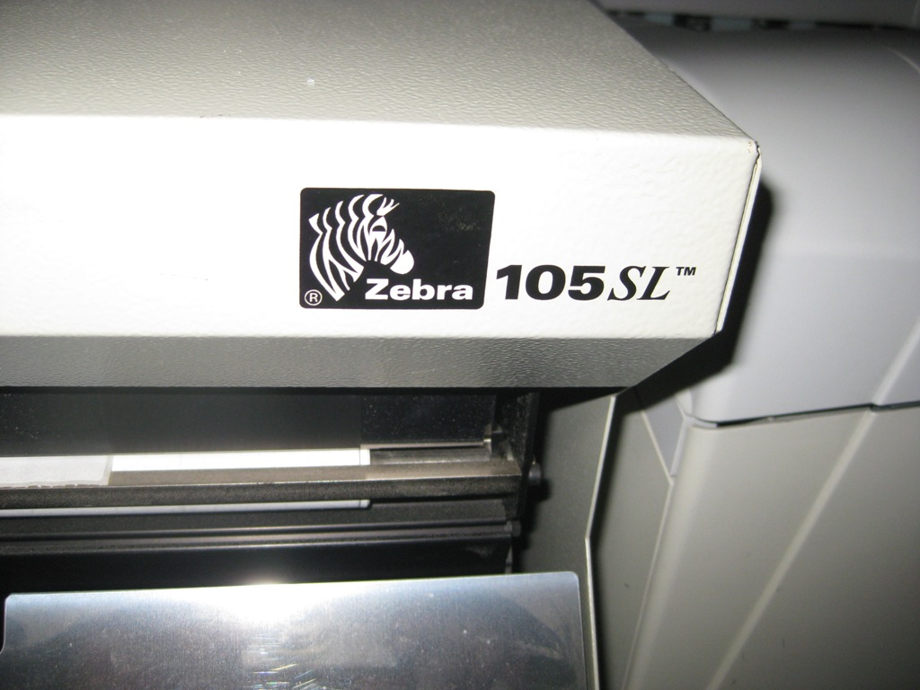

Slide 3
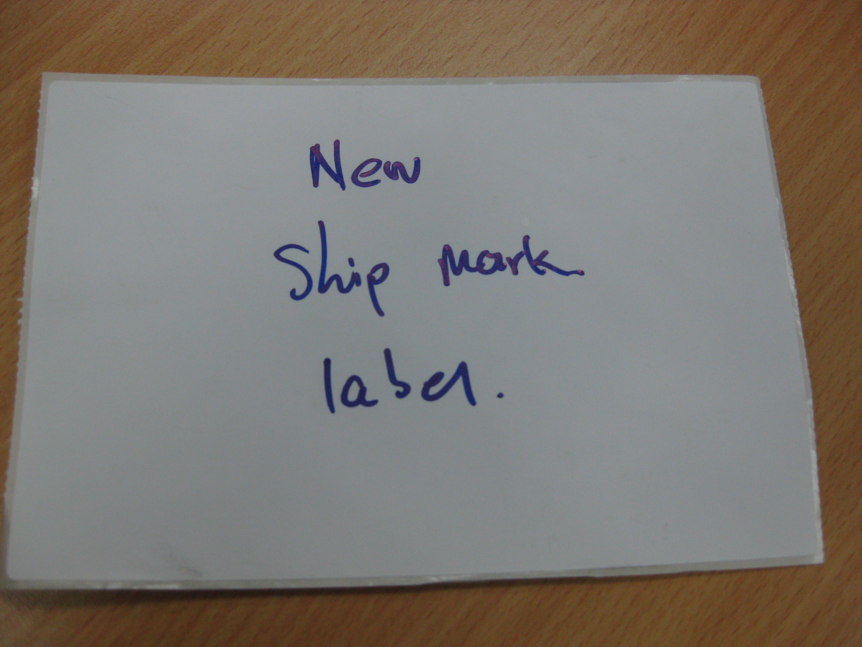
The airlog new ship mark will printed based of the no of copy need .
Eg. The shpt contain 2 pcs , the printed label will indicate 1/ 2 and 2 /2 for 2 copy each.

